Slide 1
Artificial Intelligence project
Mental Fitness Tracker
Presented by:Debasis Pradhan

Slide 2

STUDENT DETAILS
Name : Debasis Pradhan
SkillsBuild Email ID : 2041016213.debasispradhan@gmail.com
College Name : Institute of Technical Education and Research (ITER),SOA
College State : Odisha
AICTE Student ID : STU6463556634c381684231526
Internship ID: INTERNSHIP_168198413964410a8b547b1
Internship Domain and Internship Start and End Date:
Artificial Intelligence 12th June – 24th July

Slide 3
Agenda
Concepts of Machine Learning?
Problem statement / Project Topic
Understanding the Dataset
Project Overview
Who are the End Users
Your Solution and its Value Proposition
How did you customize the project and make it your own?
Modelling
Results
Links

Slide 4

What is Machine Learning ?
ML is a branch of artificial intelligence:
Uses computing based systems to make sense out of data
Extracting patterns, fitting data to functions, classifying data, etc
ML systems can learn and improve
With historical data, time and experience
Bridges theoretical computer science and real noise data.

Slide 5
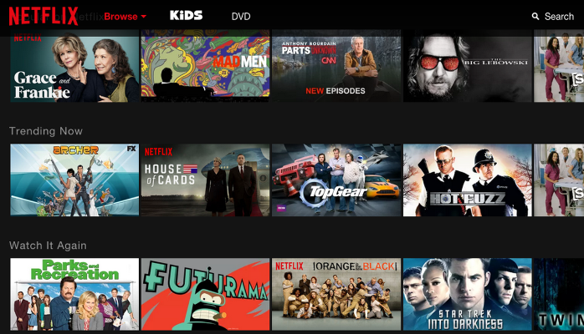
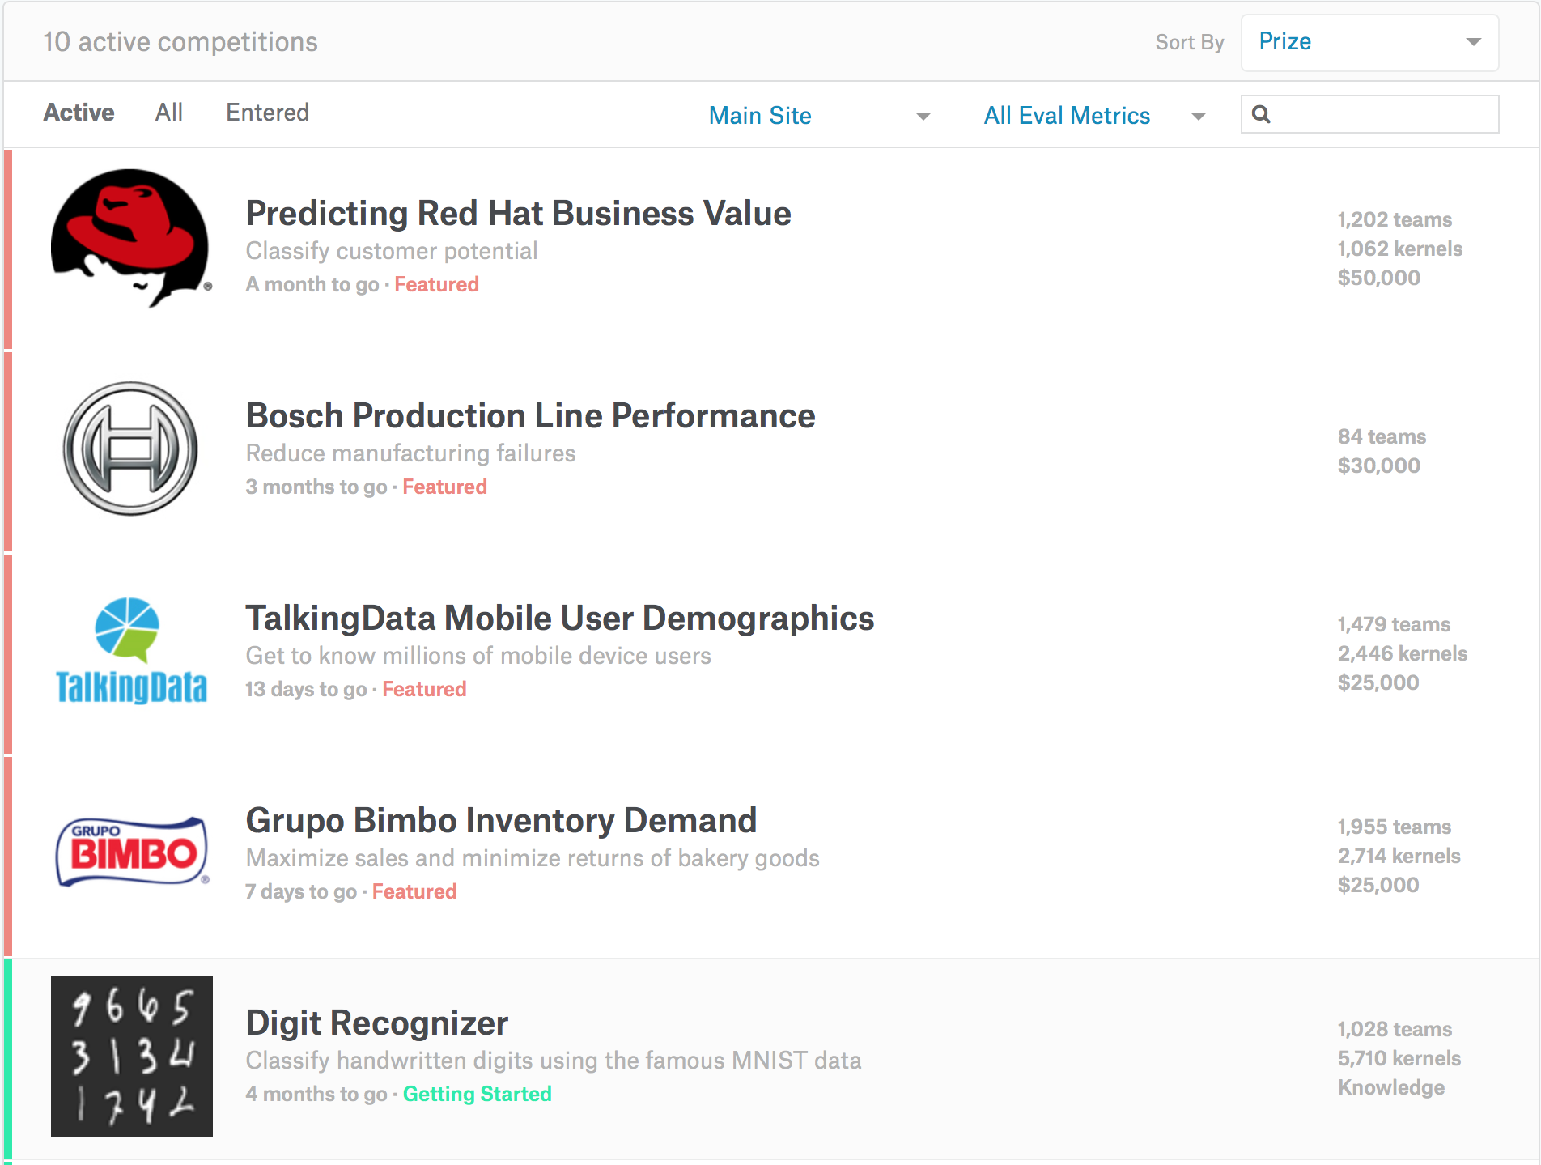
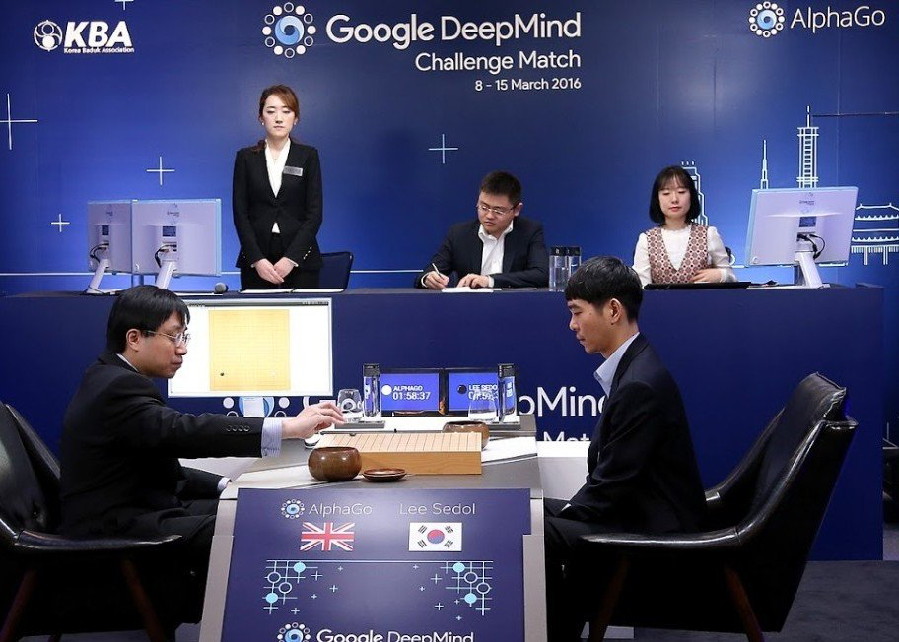
ML in real-Life

Slide 6
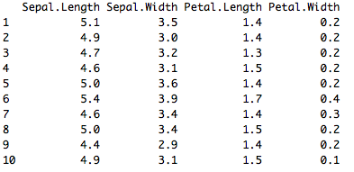
Supervised and Unsupervised Learning
Unsupervised Learning
There are not predefined and known set of outcomes
Look for hidden patterns and relations in the data
A typical example: Clustering

Slide 7
Supervised and Unsupervised Learning
Supervised Learning
For every example in the data there is always a predefined outcome
Models the relations between a set of descriptive features and a target (Fits data to a function)
2 groups of problems:
Classification
Regression

Slide 8
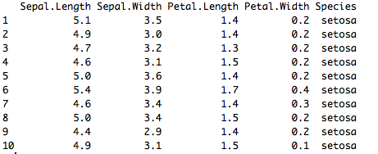
Supervised Learning
Classification
Predicts which class a given sample of data (sample of descriptive features) is part of (discrete value).
Regression
Predicts continuous values.

Slide 9
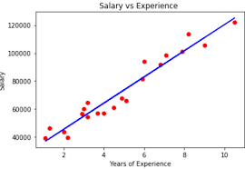
Regression
Regression in machine learning consists of mathematical methods that allow data scientists to predict a continuous outcome (y) based on the value of one or more predictor variables (x). Linear regression is probably the most popular form of regression analysis because of its ease-of-use in predicting and forecasting.

Slide 10
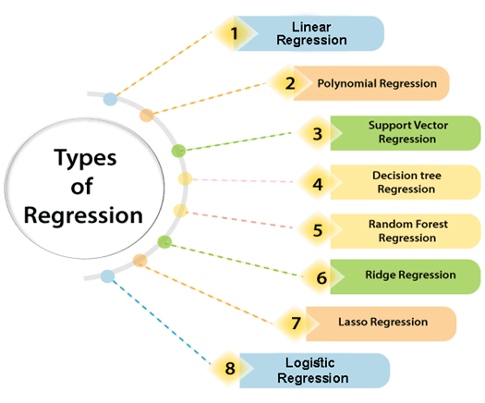
Type of Regression

Slide 11
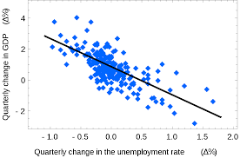
Linear Regression
Linear regression is a widely used machine learning algorithm for predicting a continuous numerical output.
It models the linear relationship between a dependent variable (Y) and one or more independent variables (X).
The linear relationship between Y and X is represented by a straight line equation: Y = mx + b, where m is the slope of the line and b is the y-intercept.

Slide 12
Linear Regression
The goal of linear regression is to find the best-fit line that minimizes the difference between the predicted and actual values of Y.
Linear regression can be used for both simple linear regression, which involves a single independent variable, and multiple linear regression, which involves multiple independent variables.
Some common applications of linear regression include predicting sales based on advertising spend, predicting housing prices based on features such as square footage and number of bedrooms, and predicting stock prices based on economic indicators.

Slide 13
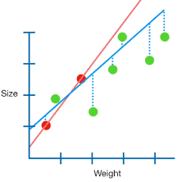
Ridge Regression
Ridge Regression is a regularized form of Linear Regression that is used to prevent overfitting.
It adds a penalty term to the standard Linear Regression cost function, which shrinks the coefficients towards zero.

Slide 14
Ridge Regression
The amount of shrinkage is controlled by a hyperparameter called the regularization parameter, which is denoted by lambda.
Ridge Regression is particularly useful when dealing with multicollinearity, which is when two or more independent variables are highly correlated with each other.

Slide 15
Gradient Boosting Regression
Gradient Boosting Regression is a powerful machine learning algorithm that uses an ensemble of weak prediction models to make accurate predictions.
It combines multiple decision trees with boosting to create a strong prediction model.
In Gradient Boosting, each new tree is built to correct the errors of the previous tree.
The final prediction of the model is a weighted sum of the predictions made by all the individual trees.
Gradient Boosting is particularly useful for nonlinear regression problems and can handle both continuous and categorical input variables.

Slide 16
Problem statement
The objective of the project is to prepare a machine learning model that can predict the mental fitness of the user into using various python based machine learning tools and data science libraries
The ‘target’ dataset has 10 sections with Country, Year, Schizophrenia, Bipolar_disorder, Eating_disorders, Anxiety, Drug_usage, Depression, Alcohol, Mental_fitness.
Given the images of the articles, we need to predict the profit earned by the company using the best Regression model.

Slide 17
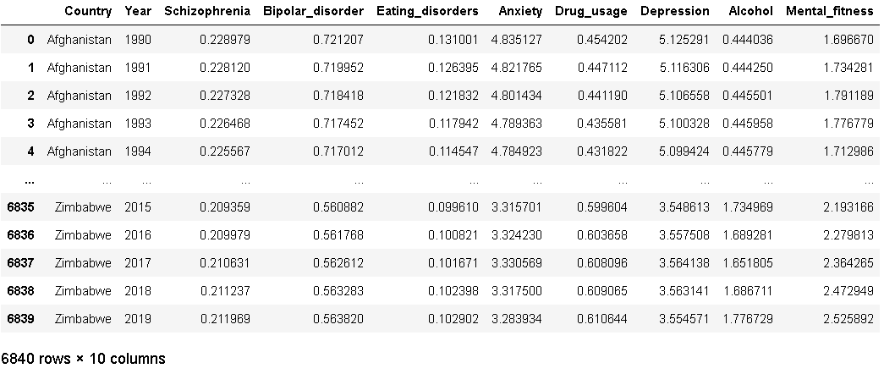
Understanding the Dataset
The prevalence-by-mental-and-substance-use-disorder _AI.CSV dataset contains information related to the prevalence of mental and substance use disorders across different countries and years. Each row in the dataset represents a specific country for a particular year.

Slide 18
Project Overview
The Mental Fitness Tracker is a machine learning-based project that aims to address the critical need for better mental health monitoring and early intervention. This project leverages the power of data analysis and predictive modeling to provide individuals with personalized insights into their mental fitness and potential risk factors for mental health issues.
Purpose : The primary purpose of the Mental Fitness Tracker is to empower individuals to take charge of their mental well-being by offering a reliable and user-friendly tool for mental fitness tracking. By accurately predicting mental fitness based on various attributes, the project aims to facilitate early detection of potential mental health issues, allowing users to seek appropriate support and interventions promptly.

Slide 19
Project Overview
Scope s: The scope of the Mental Fitness Tracker encompasses a broad range of users, including individuals eeking to assess their mental fitness regularly, mental health professionals involved in patient evaluation and support, as well as researchers and policymakers looking to make data-driven decisions. The project's scope also includes customization options to cater to diverse user needs and contextual settings.
Objectives: The key objectives of the Mental Fitness Tracker project are as follows:
Accurate Mental Fitness Prediction: Utilize machine learning algorithms to predict an individual's mental fitness based on relevant attributes, such as prevalence rates of specific mental and substance use disorders, country, and year.
Support Mental Health Professionals: Support mental health practitioners with evidence-based data and insights to aid in patient evaluation and treatment planning.
Promote Evidence-Based Policies: Contribute to evidence-based mental health policies and initiatives by providing valuable data and trends related to mental fitness on a larger scale.

Slide 20
Who are the End Users
The end users of the Mental Fitness Tracker project encompass various groups with distinct characteristics and needs. Let's identify and describe these target audiences and how they will benefit from the solution:
Individuals Seeking Mental Fitness Assessment:
General population individuals who wish to assess their mental fitness and gain insights into their mental well-being. Users may be interested in understanding their mental health status, identifying potential risk factors, and receiving personalized feedback to enhance their overall mental well-being. The Mental Fitness Tracker provides individuals with accurate mental fitness predictions and personalized recommendations. Users can proactively take measures to improve their mental health, leading to enhanced self-awareness and better coping strategies.
Mental Health Professionals:
Mental health practitioners, including psychologists, psychiatrists, counselors, and therapists. Professionals require reliable and data-driven tools to aid in patient evaluation, treatment planning, and progress monitoring. The Mental Fitness Tracker offers evidence-based data and insights, enabling mental health professionals to make informed decisions and develop personalized treatment plans. It supports their efforts in providing targeted support to patients and tracking their progress effectively.

Slide 21
Solution and Value Proposition
My project can provide some broad benefits that users might receive :
The Mental Fitness Tracker Utilizes machine learning algorithms to predict mental fitness, Offers a user-friendly interface for easy input of personal data and Provides real-time feedback and personalized recommendations.
The user can set and track objectives for improving their mental health with the help of the Mental Fitness Tracker, such as increasing exercise.
Value Proposition:
Encourages users to take initiative for improved mental health.
Enhances mental health practitioners' decision-making process.
Supports evidence-based mental health policies.

Slide 22
How did you customize the project and make it your own?
Here are some points of how I customized the tracker for mental fitness:
Multiple Regression Algorithms : Rather than relying on a single regression algorithm, I expanded the project's scope by incorporating multiple regression algorithms. This approach allowed you to explore various modeling techniques and assess their performance on the mental fitness prediction task.
Evaluation of Performance Metrics: I went beyond model training and prediction by evaluating the performance of each regression algorithm using essential metrics such as Mean Squared Error (MSE), Root Mean Squared Error (RMSE), and R-squared (R2) score. This comprehensive evaluation enabled me to gain insights into how well each model performed in predicting mental fitness, providing a more detailed assessment of their effectiveness.
User-Centric and Intuitive Mental Fitness Tracking Tool: I took special care to design the Mental Fitness Tracker with a user-centric approach, prioritizing the user experience and ease of use. By creating an intuitive interface, I ensured that users can navigate the tool effortlessly and input their data seamlessly, making the mental fitness tracking process more engaging and accessible.
By incorporating multiple regression algorithms and evaluating their performance using various metrics, I have significantly improved the project's analytical rigor and model selection process. This approach allowed me to identify the most suitable algorithm for the mental fitness prediction task, leading to a more robust and accurate Mental Fitness Tracker.

Slide 23
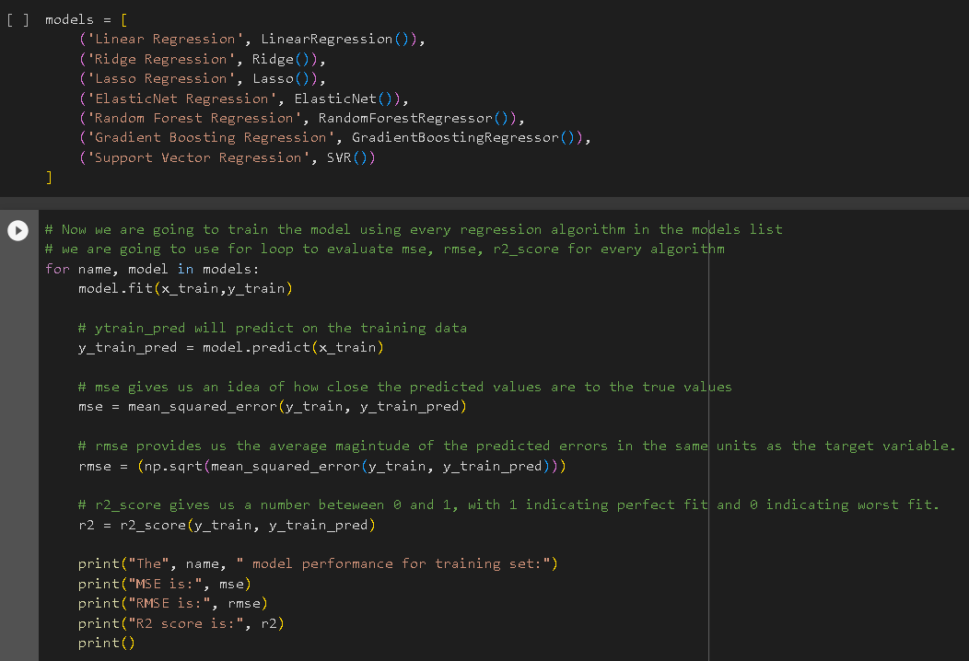
How did you customize the project and make it your own?

Slide 24
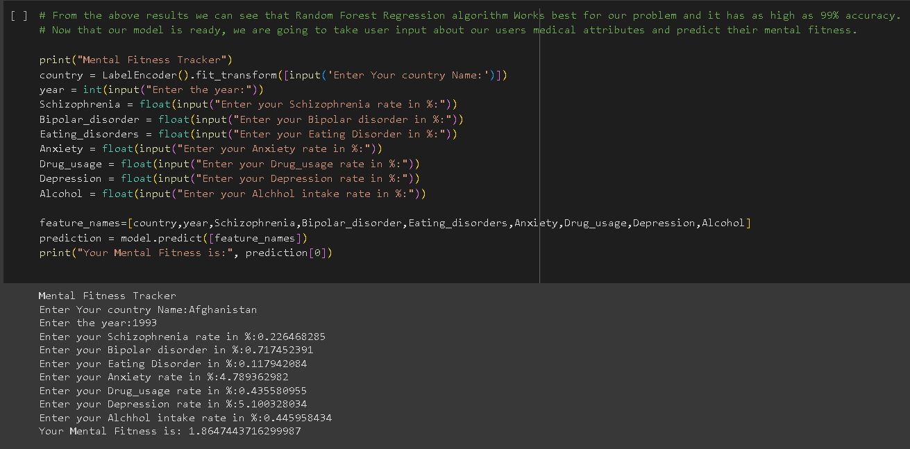
How did you customize the project and make it your own?

Slide 25
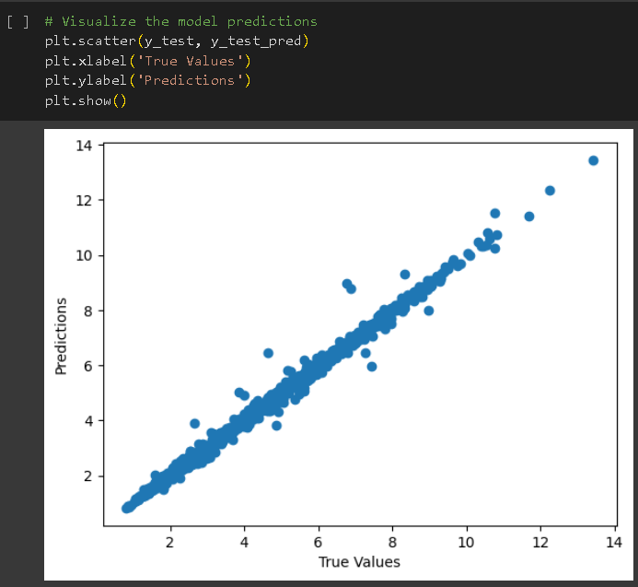
How did you customize the project and make it your own?

Slide 26
Modelling
Here are some points of how I modelled the tracker for mental fitness:
Regression Algorithms:
In the project, I employed several regression algorithms, including Linear Regression, Ridge Regression, Lasso Regression, ElasticNet Regression, Random Forest Regression, Gradient Boosting Regression, and Support Vector Regression.
The utilization of a diverse set of regression techniques allowed me to explore different approaches to predict mental fitness based on the given attributes.
Model Evaluation:
After training each regression model, I evaluated their performance using essential metrics such as Mean Squared Error (MSE), Root Mean Squared Error (RMSE), and R-squared (R2) score.
This evaluation process provided quantitative insights into the accuracy and effectiveness of each model, allowing me to identify the best-performing algorithm for the Mental Fitness Tracker.

Slide 27
Modelling
Here are some points of how I modelled the tracker for mental fitness:
Utilization of Technology Principles:
Python and Data Analysis Libraries:
The project leveraged Python, a powerful programming language known for its simplicity and flexibility in data analysis and machine learning tasks.
I utilized various Python libraries, such as NumPy, pandas, and matplotlib, to handle data manipulation, analysis, and visualization. These libraries enabled efficient data preprocessing and exploration.
Machine Learning with scikit-learn:
The scikit-learn library is a fundamental tool in machine learning projects. It provides a wide range of regression and evaluation functions, streamlining the implementation of different regression algorithms.
By using scikit-learn, you reduced the development time and ensured that your models were built on well-tested and reliable implementations.

Slide 28
Modelling

Slide 29
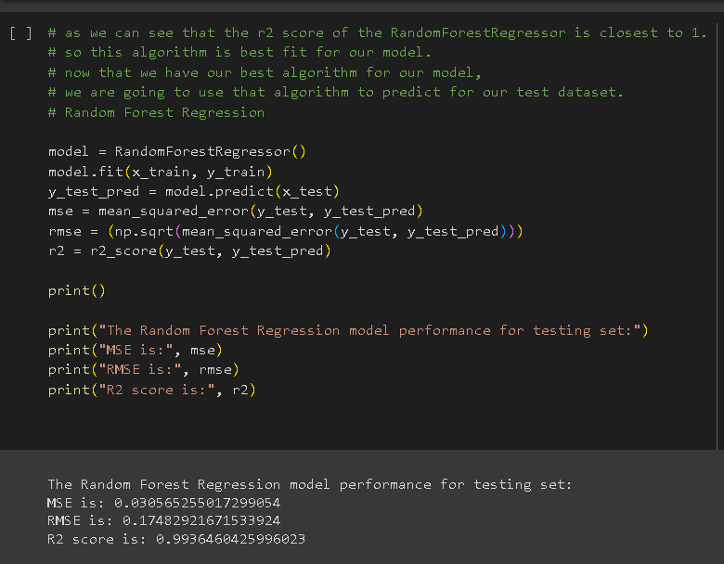
Modelling

Slide 30
Results
The outcomes of the Mental Fitness Tracker project demonstrate the effectiveness of the developed solution in predicting mental fitness based on various attributes. The results include quantitative performance metrics, qualitative feedback, and evidence of the project's impact.
Quantitative Performance Metrics:
The evaluation of the regression models using key metrics (MSE, RMSE, and R2 score) revealed the following results:
Linear Regression: MSE = 1.38995937 , RMSE = 1.17896538, R2 score = 0.74132457
Ridge Regression: MSE =1.40878907 , RMSE = 1.18692420, R2 score = 0.73782031
Lasso Regression: MSE =3.7554505 , RMSE = 1.93789848, R2 score = 0.30109989
ElasticNet Regression: MSE = 3.51916311, RMSE =1.87594326 , R2 score = 0.34507366
Random Forest Regression: MSE =0.00502030 , RMSE =0.07085410 , R2 score = 0.99906570
Gradient Boosting Regression: MSE =0.24302526 , RMSE = 0.49297593, R2 score = 0.95477230
Support Vector Regression: MSE =5.36587530 , RMSE = 2.31643590, R2 score = 0.00139523
The Random Forest Regression algorithm demonstrated the highest accuracy, with an R2 score close to 99%, making it the best fit for the Mental Fitness Tracker.
In conclusion, the results of the Mental Fitness Tracker project demonstrate its effectiveness and accuracy in predicting mental fitness.

Slide 31
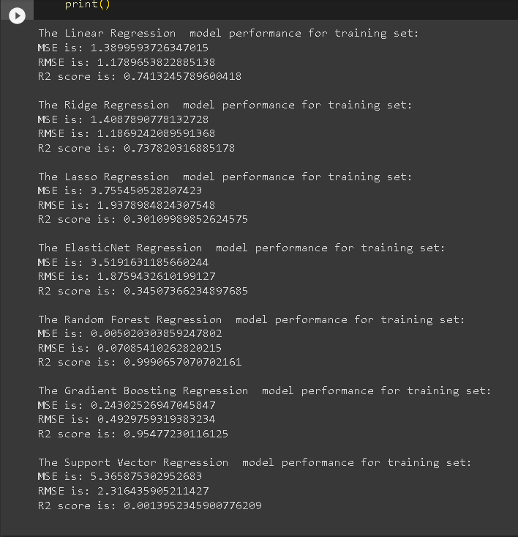
Results

Slide 32
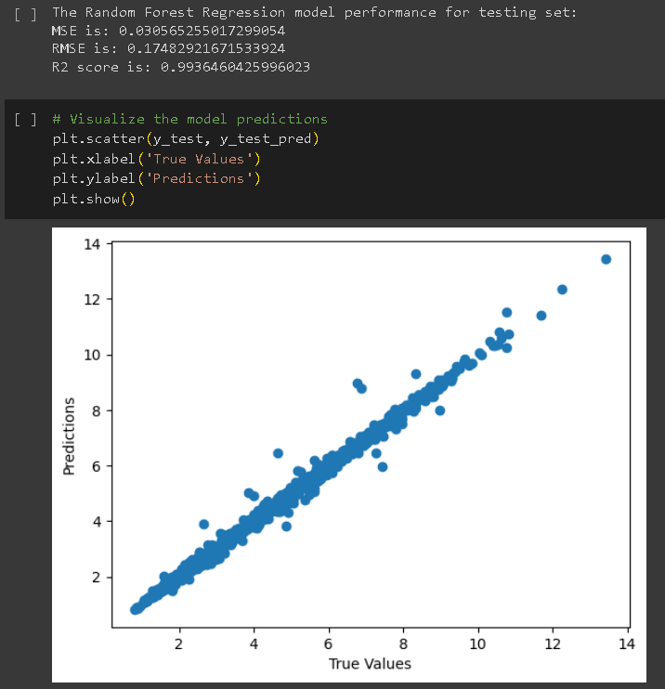
Results

Slide 33
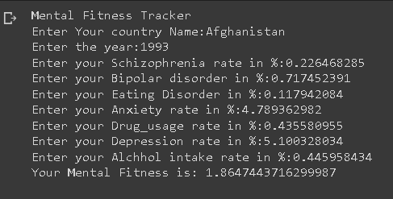
Results

Slide 34
Links
Project Link :
https://colab.research.google.com/drive/1qyJhWSAsD8PduY3nSQxv5kTVXLKC3Ab3?usp=sharing
AICTE Project Video Link:
https://skillsbuild.edunetworld.com/courses/ai/mental-fitness-tracker
Regression algorithms:
https://www.analyticsvidhya.com/blog/2021/05/5-regression-algorithms-you-should-know-introductory-guide/

Slide 35
The End
Thank you

